Slide 1
RF Fingerprinting Using Deep Learning
Modulation classification in low SNR signals using transformers
Or Elia Harush Shlomi Ben Abu

Slide 2
Outline
Background
Motivation
Challenges
Model Architecture
Model Performances
Conclusion
Future Work

Slide 3
Background
Classification helps in spectrum management, security, cognitive radio, and signal intelligence.
Traditional Methods: FFT, wavelets, rule-based classification.
Can be used in cybersecurity, military, SDR, and 5G networks.

Slide 4
Motivation
Improving Wireless Communication Performance.
Enhancing Security.
Enabling Cognitive Radio & Spectrum Sensing
Notes:
RF modulation classification helps identify different signal types (e.g., AM, FM, QAM, PSK) to optimize spectrum usage and prevent interference.
Detecting unauthorized or malicious signals (e.g., spoofing, jamming, or cyberattacks in RF spectrum).Useful for military and defense applications to counteract signal spoofing.
Classifying modulation schemes helps dynamic spectrum allocation in cognitive radios.Improves spectrum efficiency by detecting vacant channels.

Slide 5
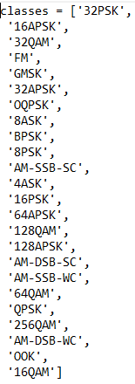
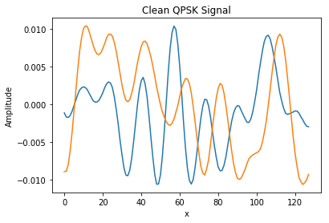
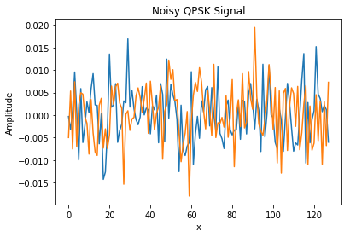
Challenges
Noise affect our ability to recognize the modulation.
Recognize signal in both low and high SNR.
Classification of many classes
High VS Low
SNR

Slide 6
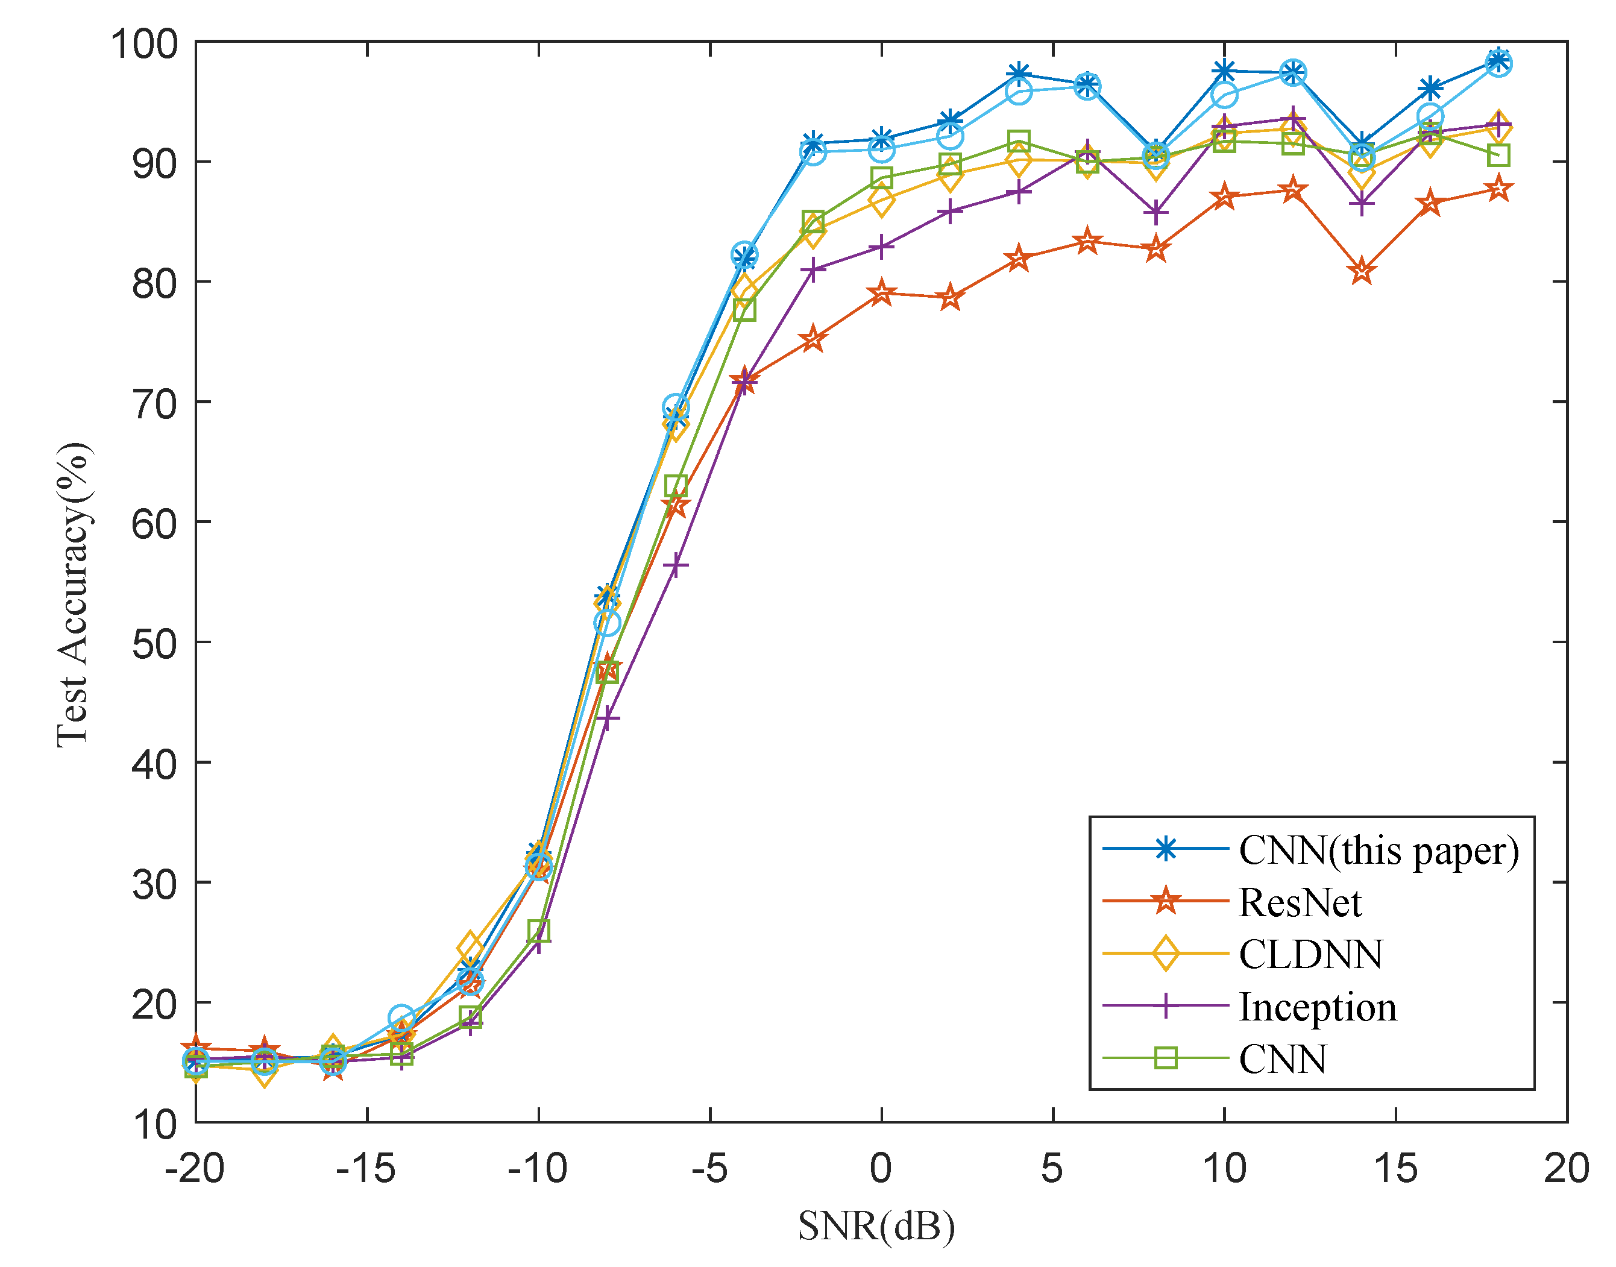
Goals
Achieve good performance for low SNR.
Get comparable results in terms of accuracy with state of the art and try to improve them.
End-to-end Deep Learning Model System.

Slide 7
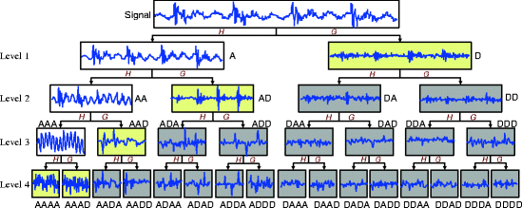
Wavelets transform
Mathematical functions for process signals at different scales and resolutions.
Remove high frequency noise from useful features.
Improved generalization.

Slide 8
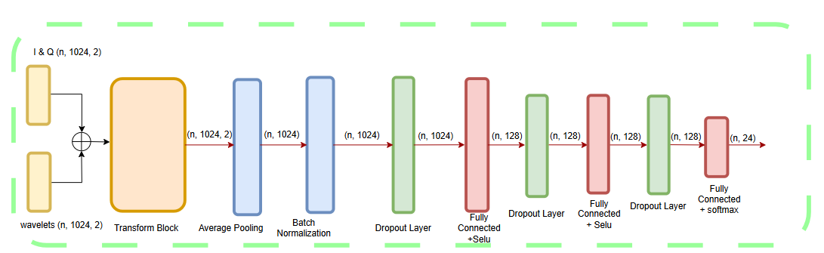
Model Architecture

Slide 9
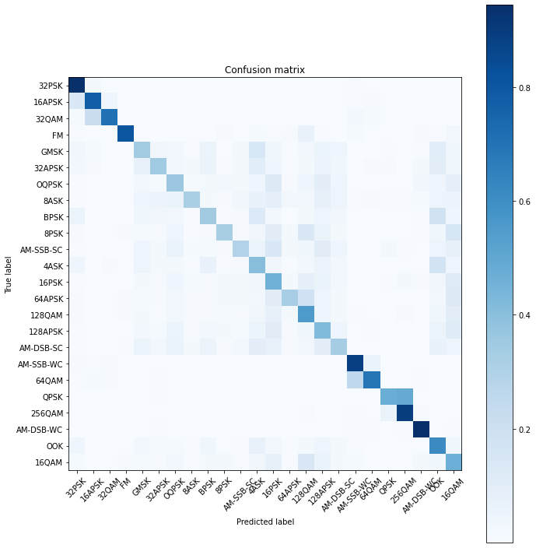
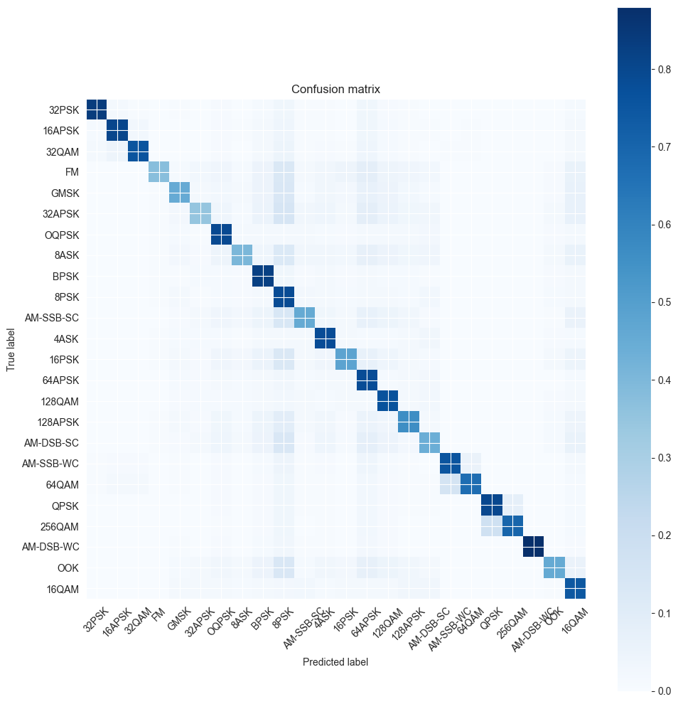

Model Performances
Baseline Model
Our Model

Slide 10
Model Performances
Our Model Accuracy | Accuracy | Modulation
0.838063 | 0.944052 | 32PSK
0.802375 | 0.781195 | 16APSK
0.7565 | 0.707122 | 32QAM
0.374938 | 0.80759 | FM
0.452813 | 0.337983 | GMSK
0.34725 | 0.344214 | 32APSK
0.791 | 0.357993 | OQPSK
0.405 | 0.318216 | 8ASK
0.822188 | 0.342938 | BPSK
0.783563 | 0.322866 | 8PSK
0.45675 | 0.297404 | AM-SSB-SC
0.781813 | 0.405197 | 4ASK
0.47925 | 0.461017 | 16PSK
0.781188 | 0.326451 | 64APSK
0.765375 | 0.554555 | 128QAM
0.560938 | 0.418839 | 128APSK
0.438813 | 0.331916 | AM-DSB-SC
0.752813 | 0.887416 | AM-SSB-WC
0.671938 | 0.690425 | 64QAM
0.797438 | 0.474065 | QPSK
0.699125 | 0.89546 | 256QAM
0.879625 | 0.943381 | AM-DSB-WC
0.453688 | 0.615378 | OOK
0.74475 | 0.47164 | 16QAM

Slide 11
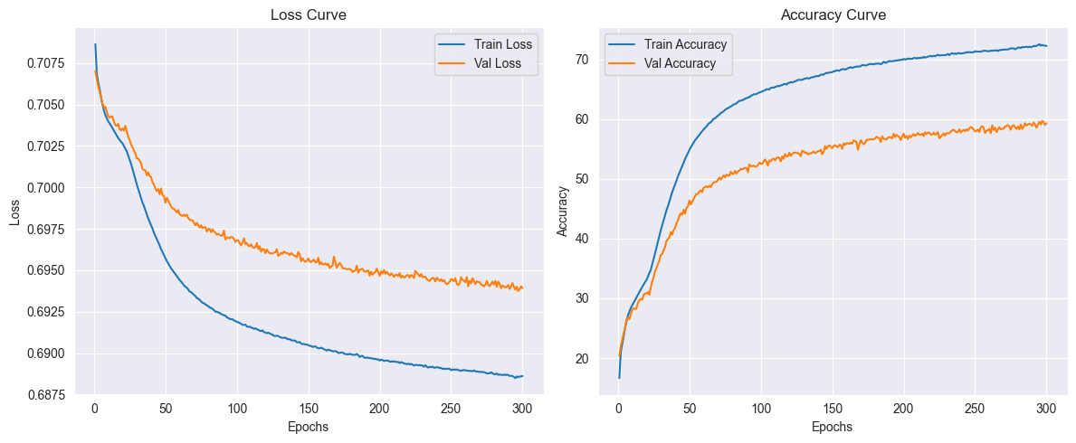
Loss & Accuracy Curves

Slide 12
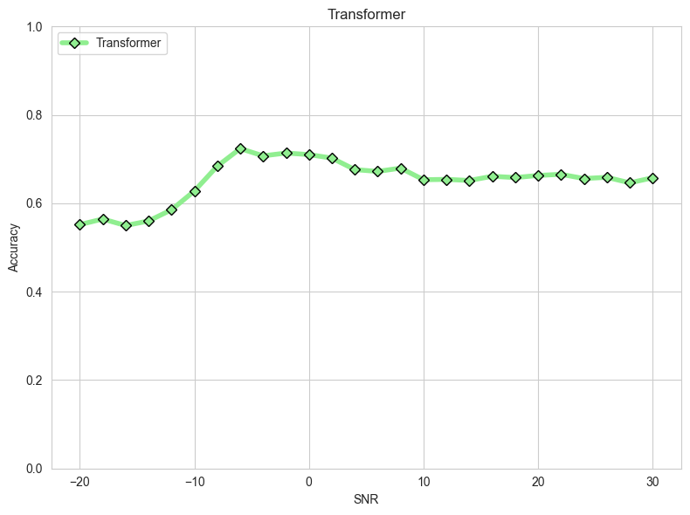
Model Performances

Slide 13
Conclusions
• Transformer-based RF fingerprinting enhances accuracy in low SNR.
Wavelet's transform can improve the accuracy in low SNR.

Slide 14
Future Work
Investigate adversarial robustness of models.
Estimate the baud rate for each signal.
Using constellation diagram with CNN to extract more features to the transformer model.

Slide 15
Thank you!

